Slide 1


Slide 2

Major Project-I (01CE0716)
Review 1
Hostel Management Sysyem
Team ID: 7CE_094
Team Member 1: Dhairya Aundhia (92200103268) (7TC3)
Team Member 2: Kunj Nirmal (92200103285) (7TC3)
Team Member 3: Rishi Patel (92200103288) (7TC3)
Guided By
Internal Guide Name: Prof. Parth Shah
Date: 23-08-2025
Department of Computer Engineering, Faculty of Technology

Slide 3
Outline
Introduction
Abstract
System Analysis
ER Diagrams
Flow Chart
Use case diagram
Tools & Technology to be used
Gantt Chart
UI screens
Expected Outcomes
References

Slide 4
Introduction
In this Hostel Management System, we have tried to design it to make hostel operations for educational institutions easier.
The system provides efficient management of student accommodation, room allocation, attendance tracking, and mess management.
It shows real-time hostel data including room availability, student records, fee management, maintenance requests.
Additionally, the system ensures secure data handling, notifications, and enhanced communication between administrators, wardens and students for effective hostel management.

Slide 5
Abstract
A Hostel Management System is a digital solution that helps institutions run hostel operations smoothly.
This project aims to create a user-friendly platform with complete hostel management features.
Key functions include automated room allocation, real-time attendance tracking, and an integrated fee collection system.
Users can manage student records, handle maintenance requests, and create detailed reports. The system also offers mess management and various access levels for different user types.
The design will be simple and responsive, using modern UI components and dashboards to show information clearly. By using modern web technologies and secure databases, this project will provide reliable and precise hostel management capabilities.

Slide 6

System Analysis
Manual Paper-Based System:
Features:
Physical attendance registers
Paper-based room allocation and maintenance records
Manual fee collection and tracking
Limitations:
Time-consuming and prone to human errors
Difficult to maintain and retrieve data quickly
No real-time updates or automation
Data can get lost or damaged easily

Slide 7

System Analysis
Commercial Hostel Management Software
Features:
Digital student records and room allocations
Online fee payment and receipts
Attendance monitoring through portals
Reporting and analytics
Limitations:
High cost of licensing and maintenance
Limited customization to specific institutional needs
User interface may be complex for non-technical users

Slide 8

System Analysis
Enterprise Resource Planning (ERP) Systems:
Features:
Integrates hostel management with academic and administrative systems.
Supports multiple hostels or campuses.
Advanced reporting, billing, and resource management.
Limitations:
Implementation complexity and long deployment timelines.
May be unnecessarily complex for standalone hostel management.
Higher infrastructure and training requirements.

Slide 9
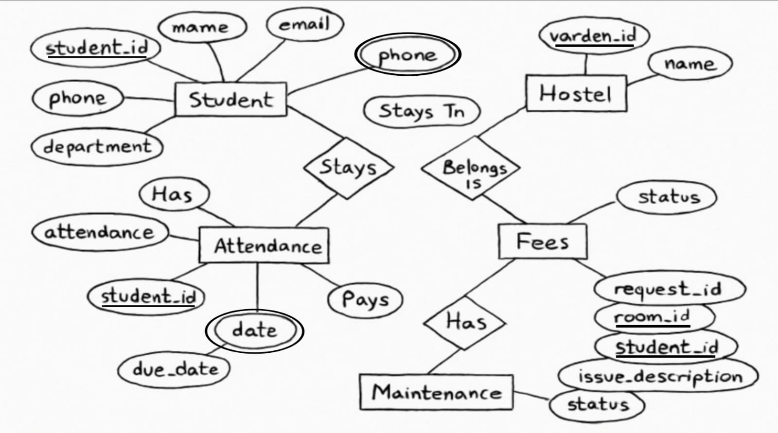
ER Diagrams

Slide 10
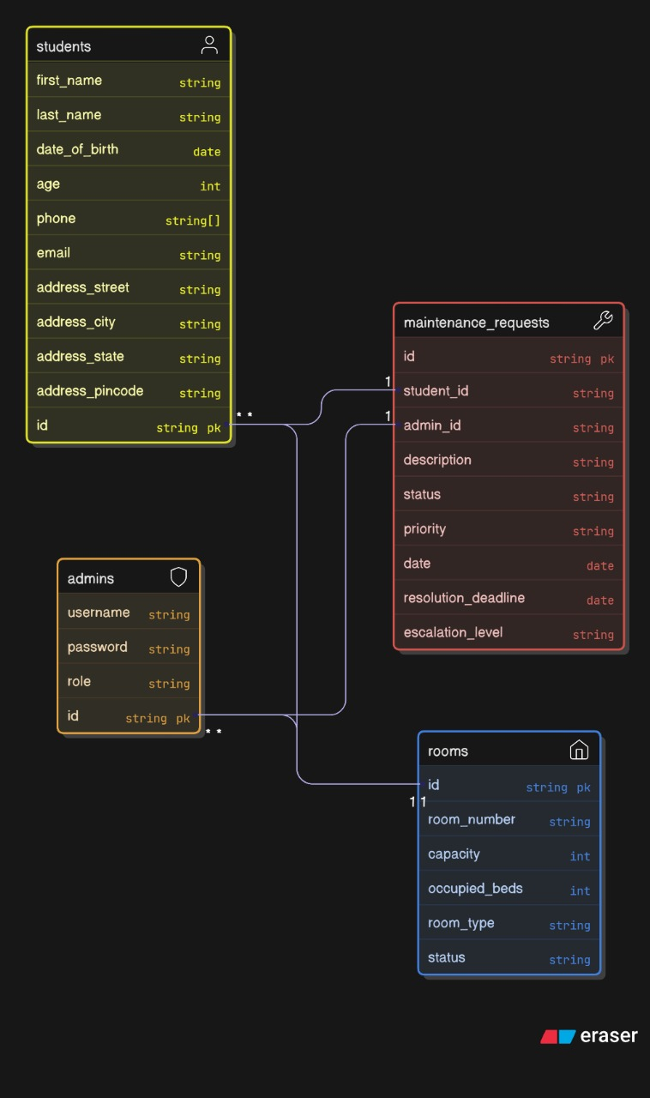
ER Diagrams

Slide 11
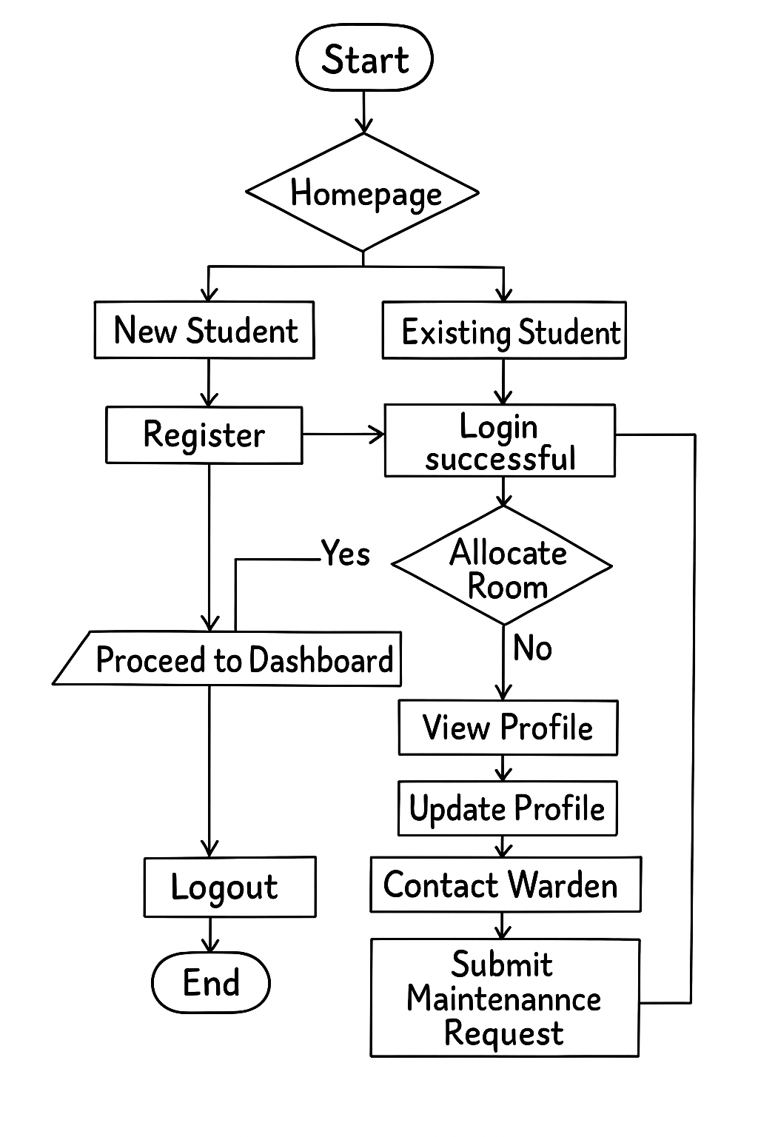
Flow Chart

Slide 12
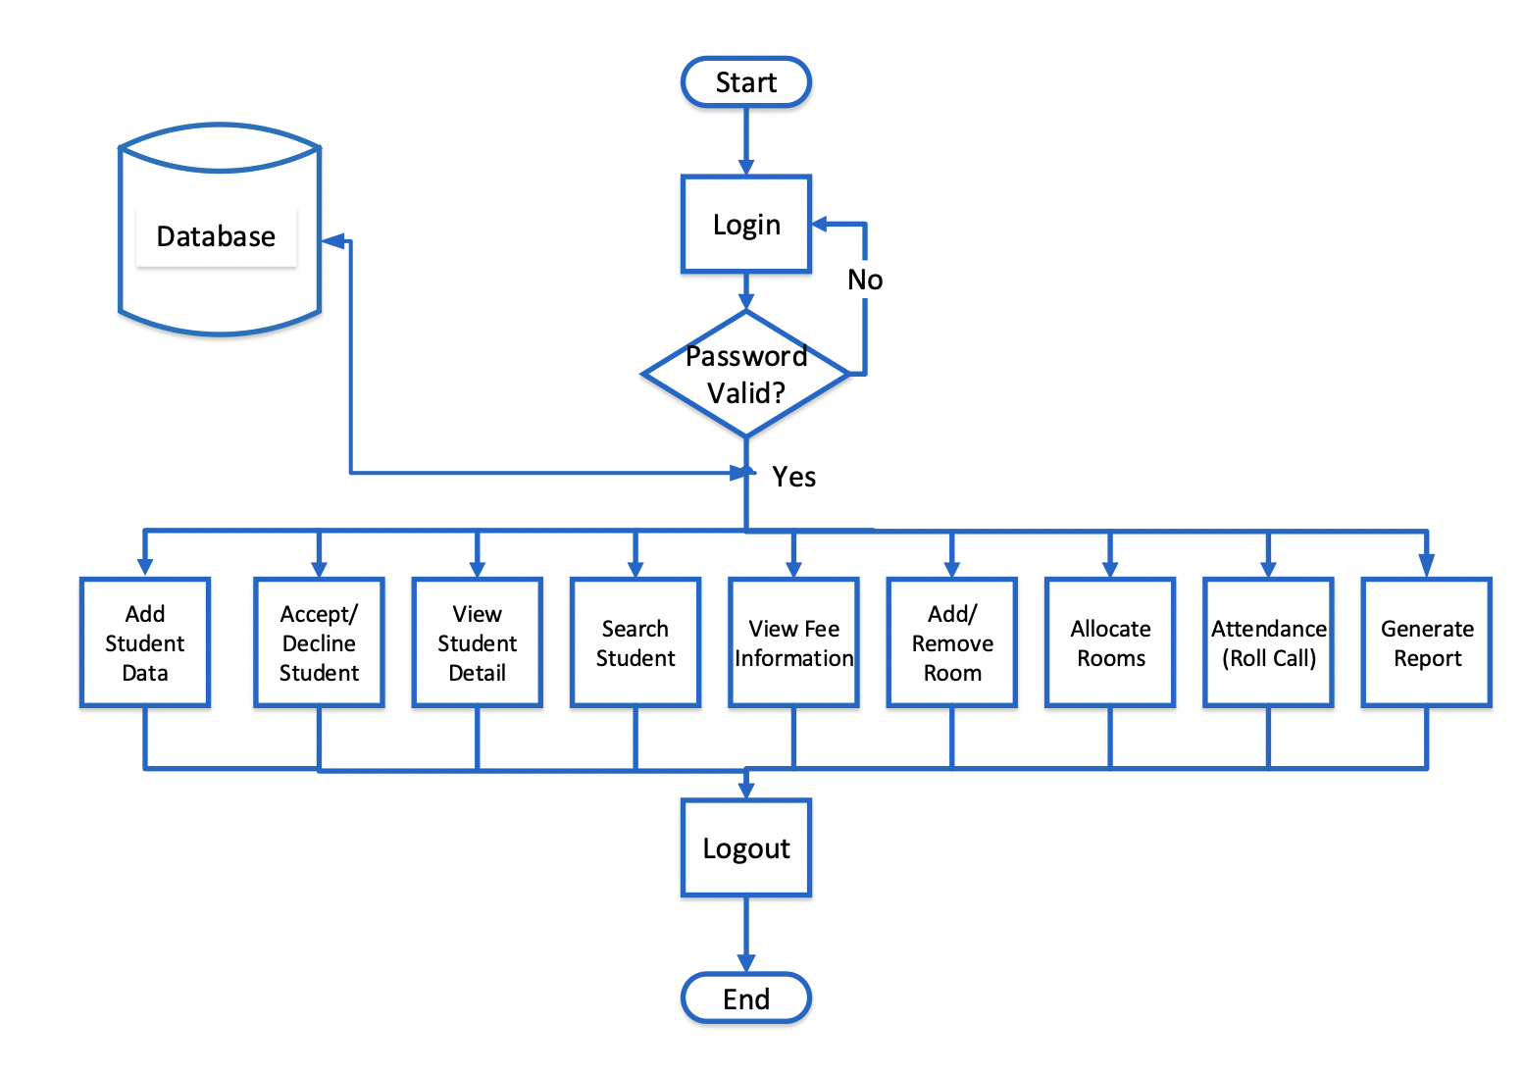
Flow Chart

Slide 13
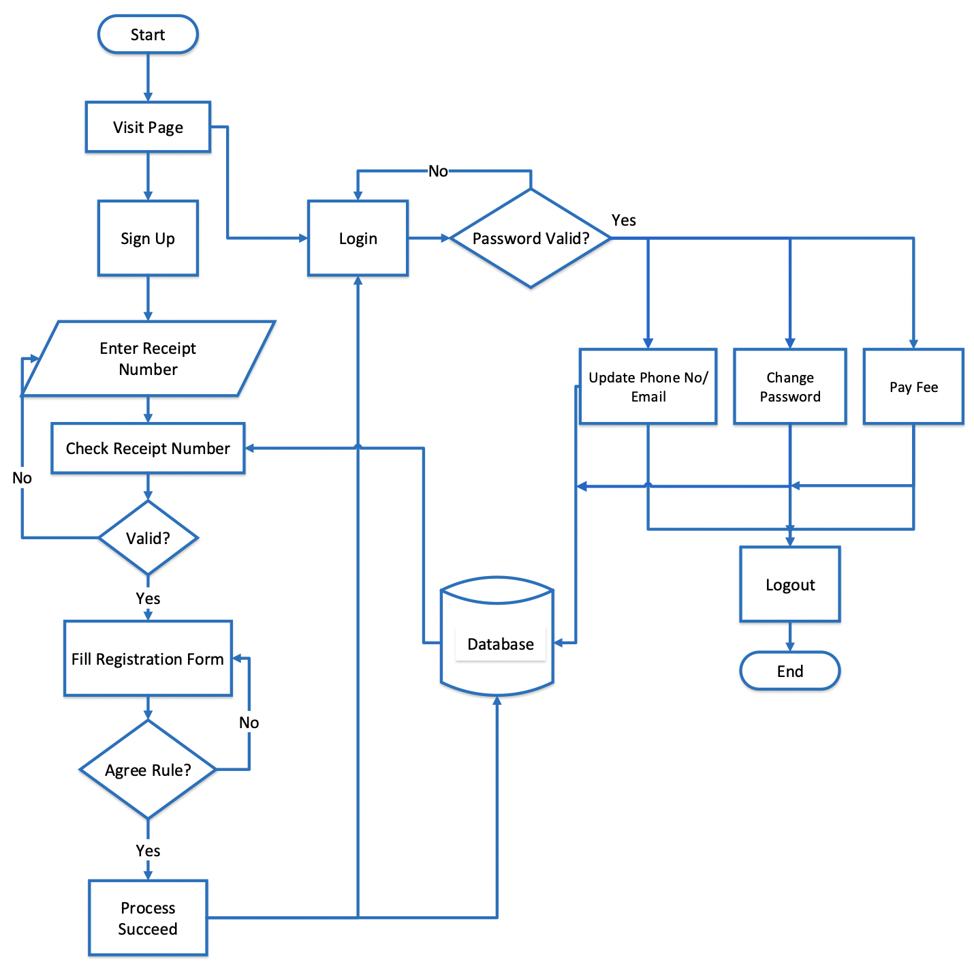
Flow Chart

Slide 14
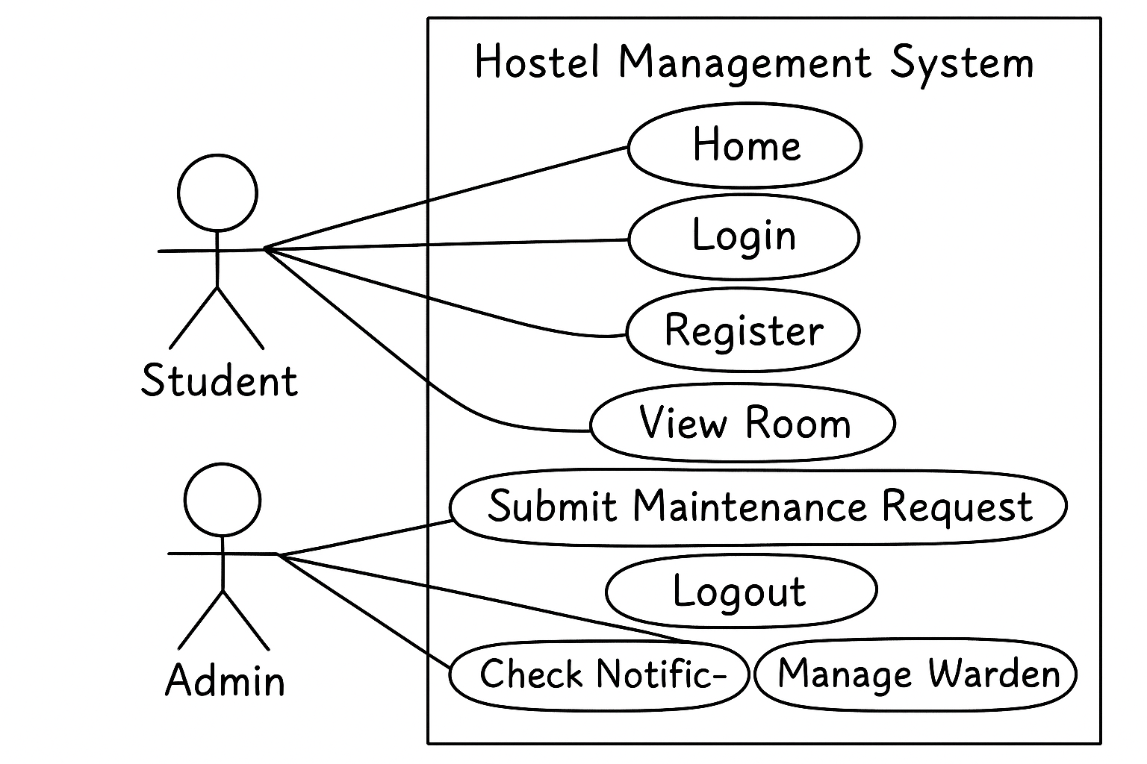
Use case diagram

Slide 15
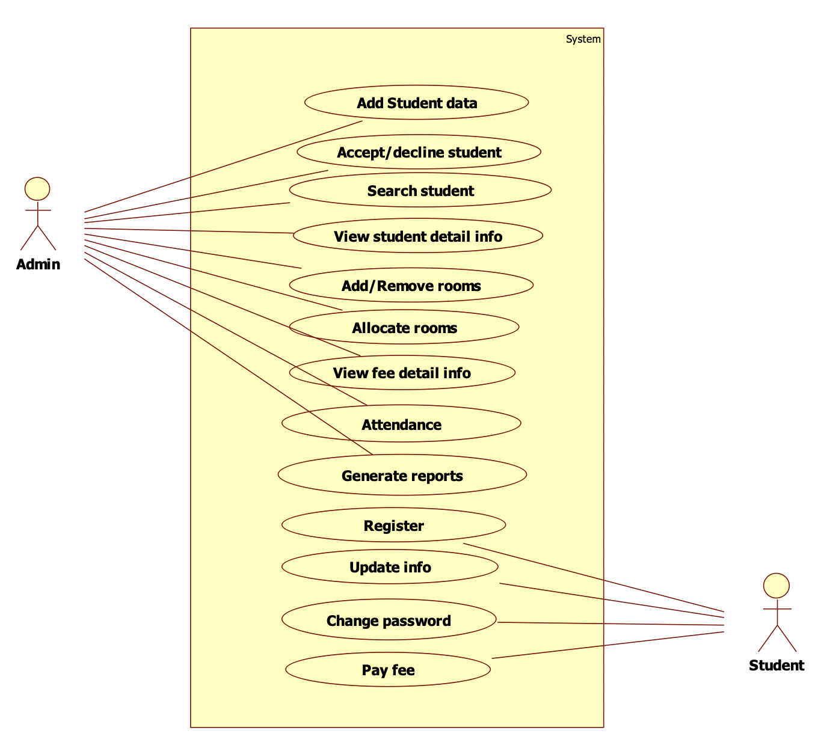
Use case diagram

Slide 16
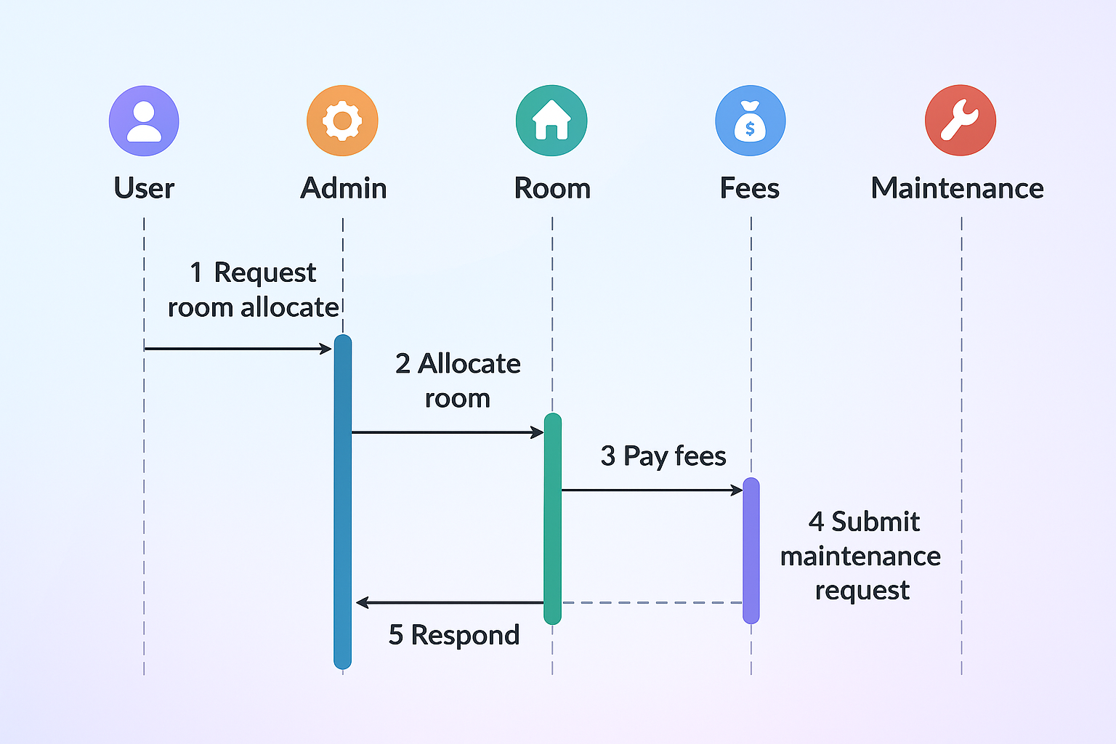
Sequence diagram

Slide 17



Tools & Technology to be used
Tool
VS Code, Mongo Compass
Technology
Mern Stack

Slide 18
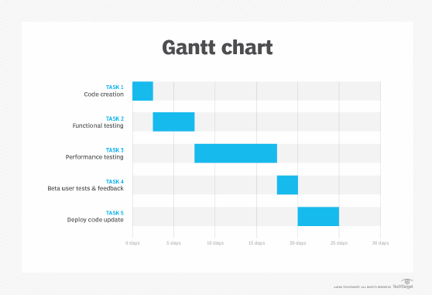
Gantt Chart

Slide 19
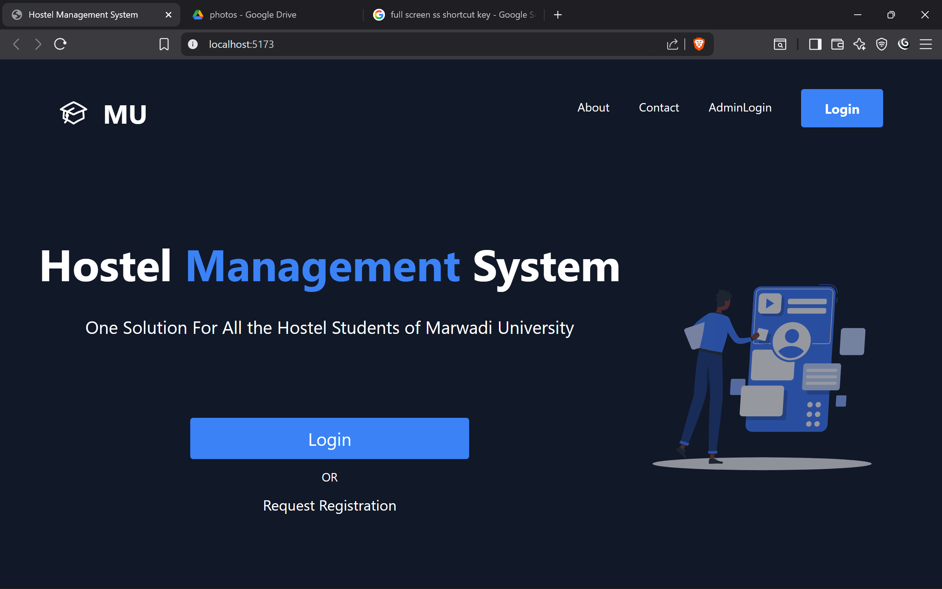
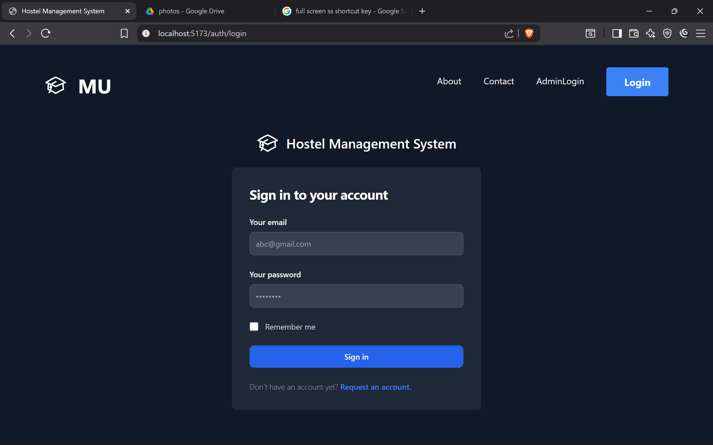
UI Screen

Slide 20
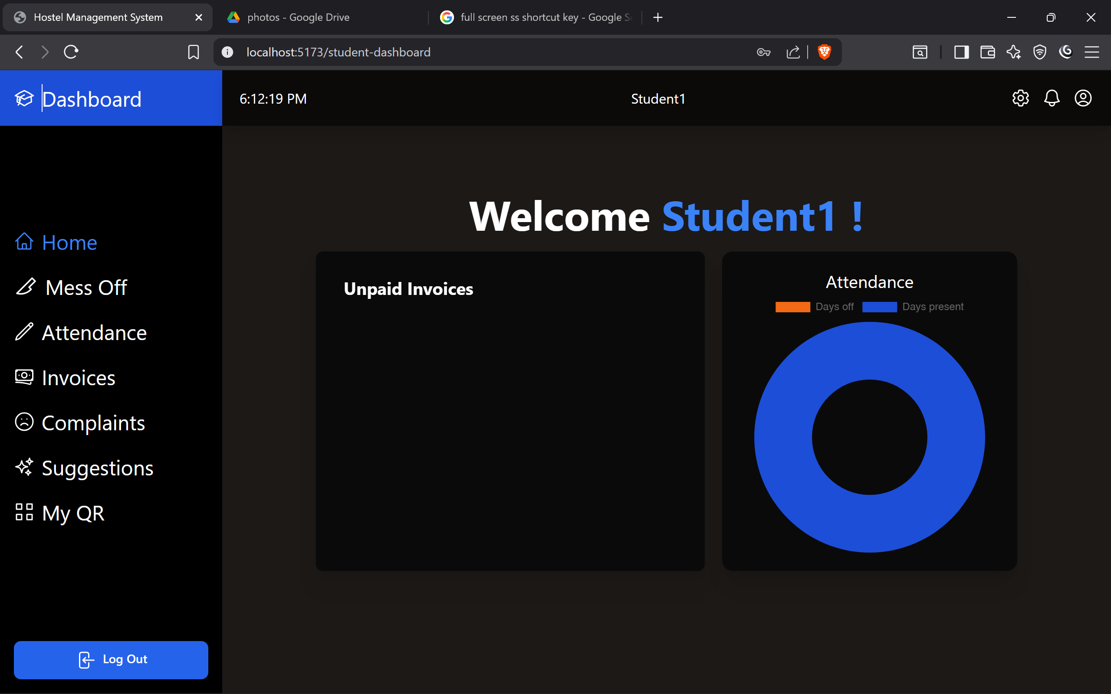
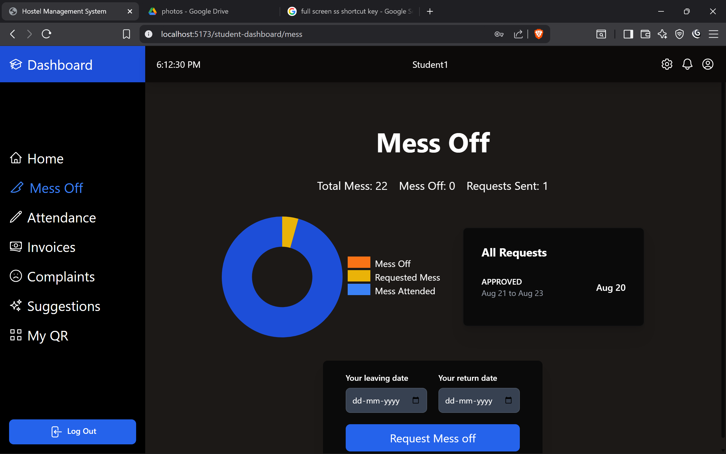
UI Screen

Slide 21
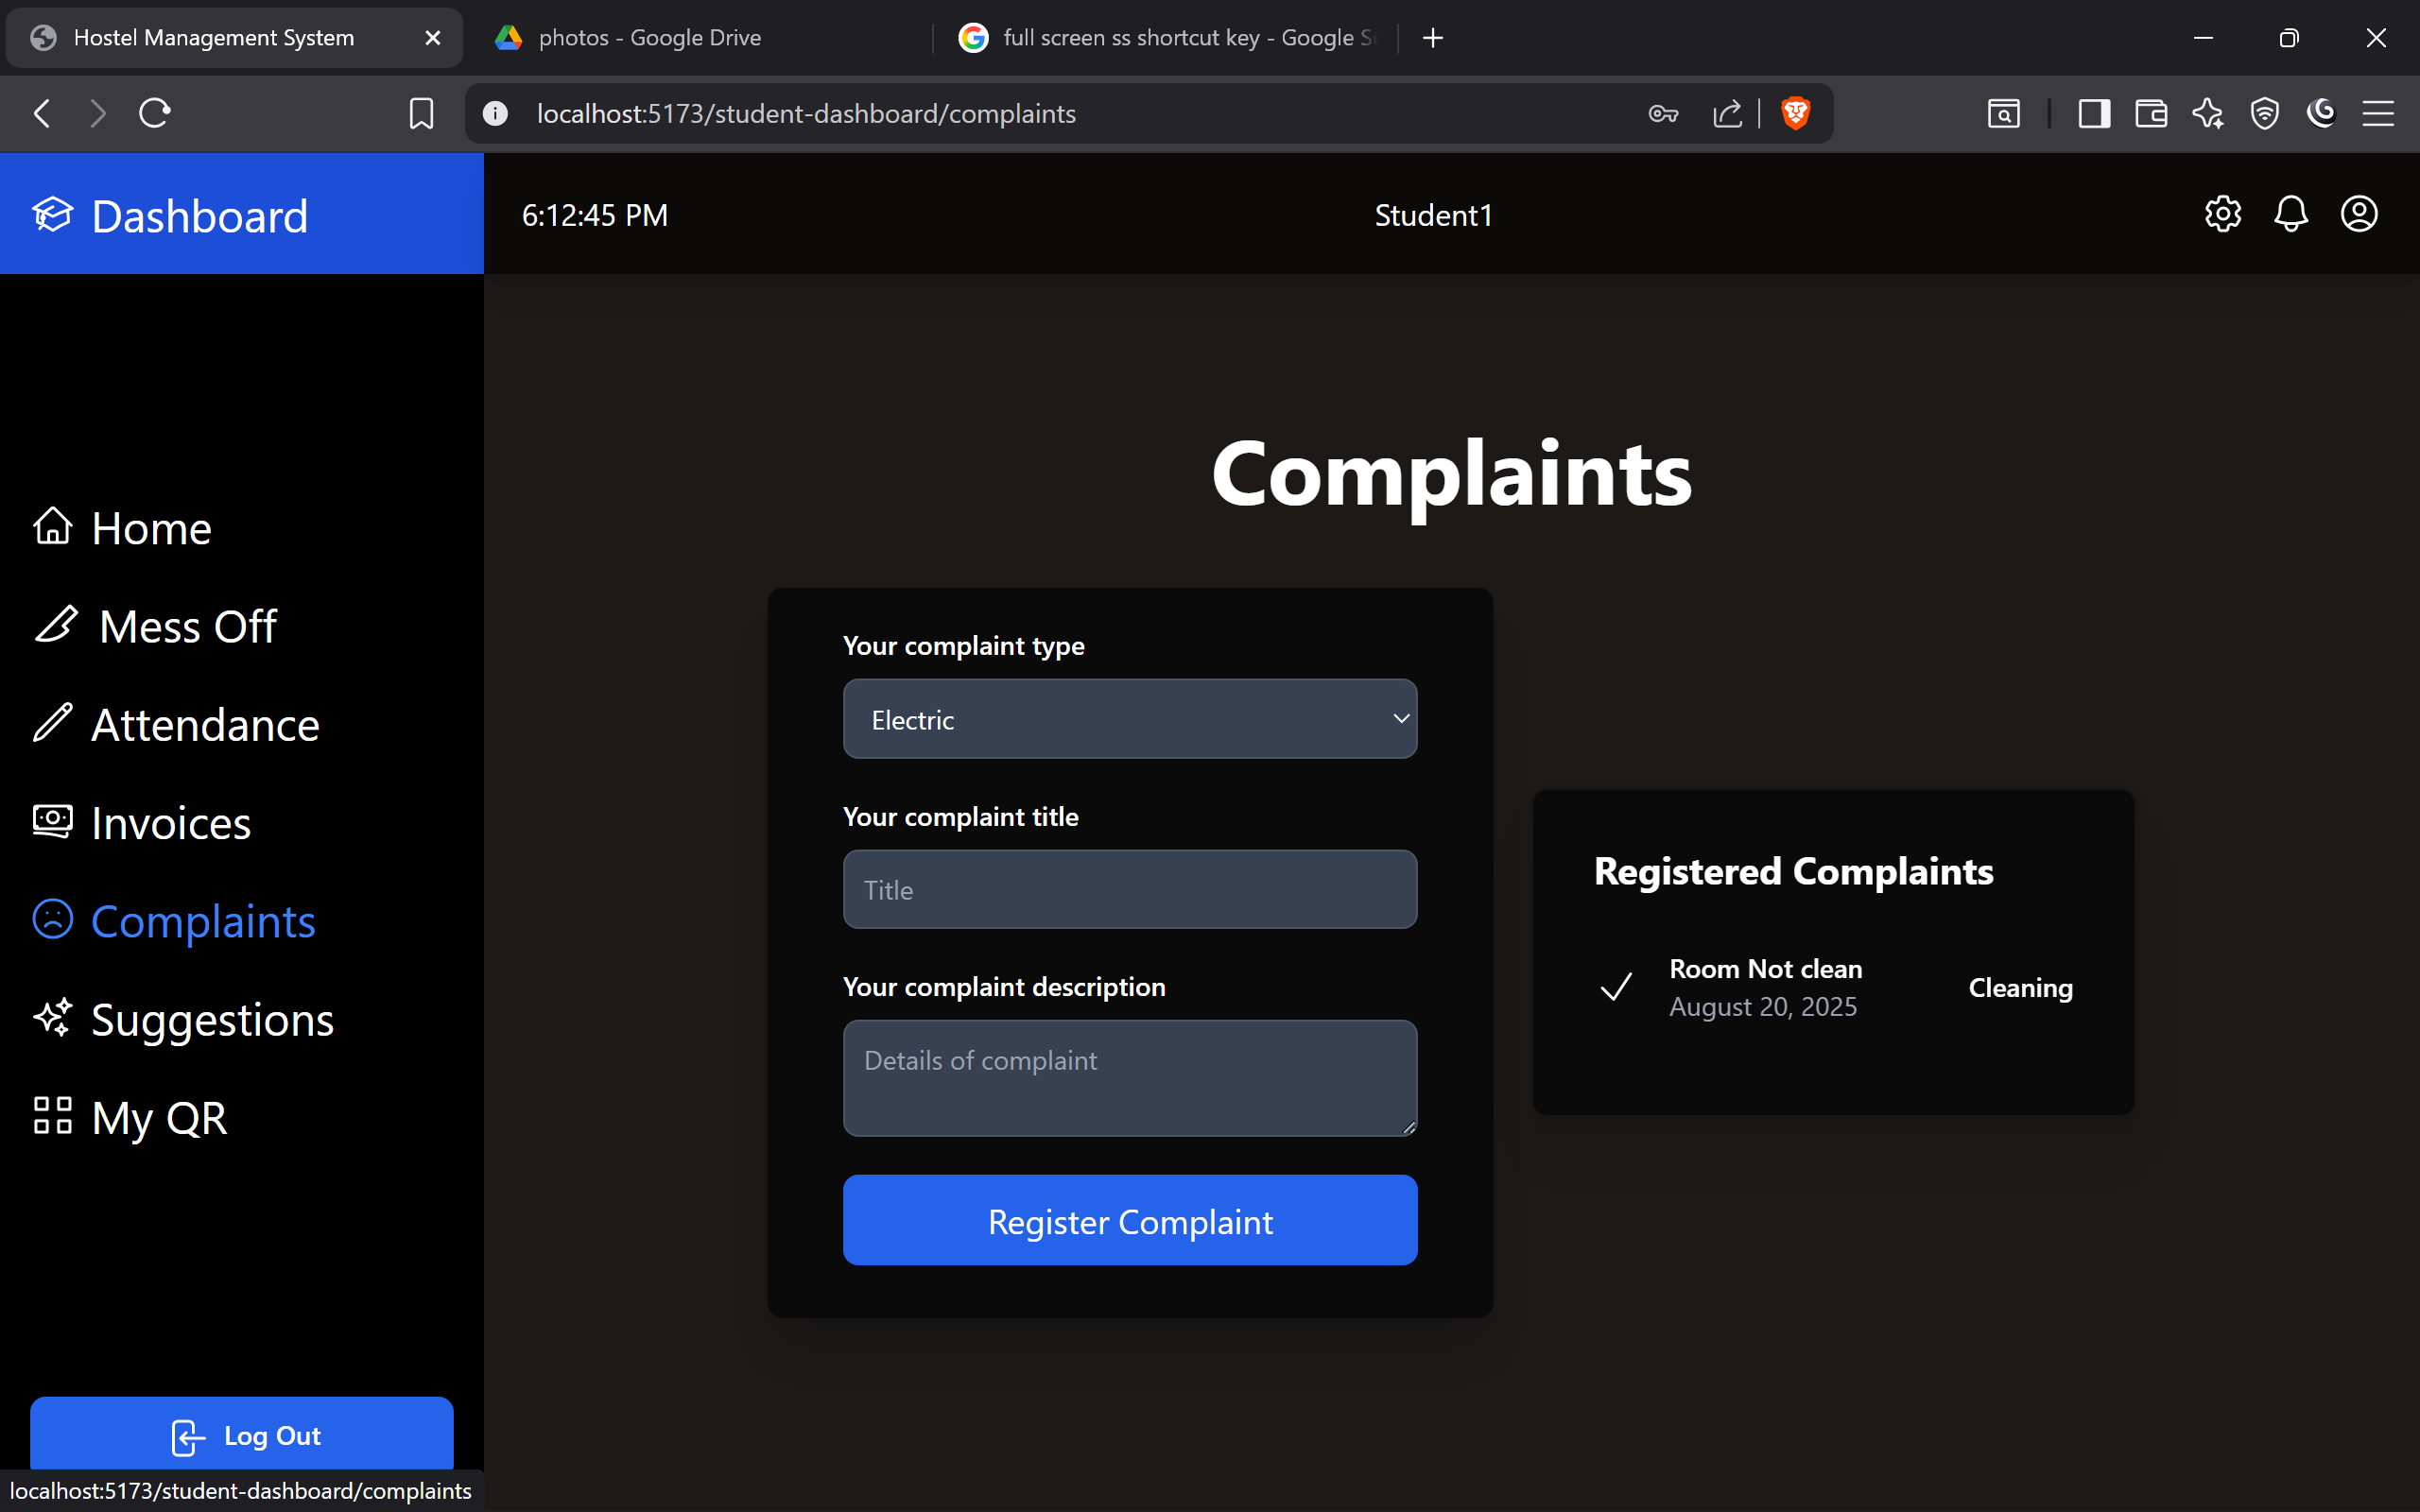
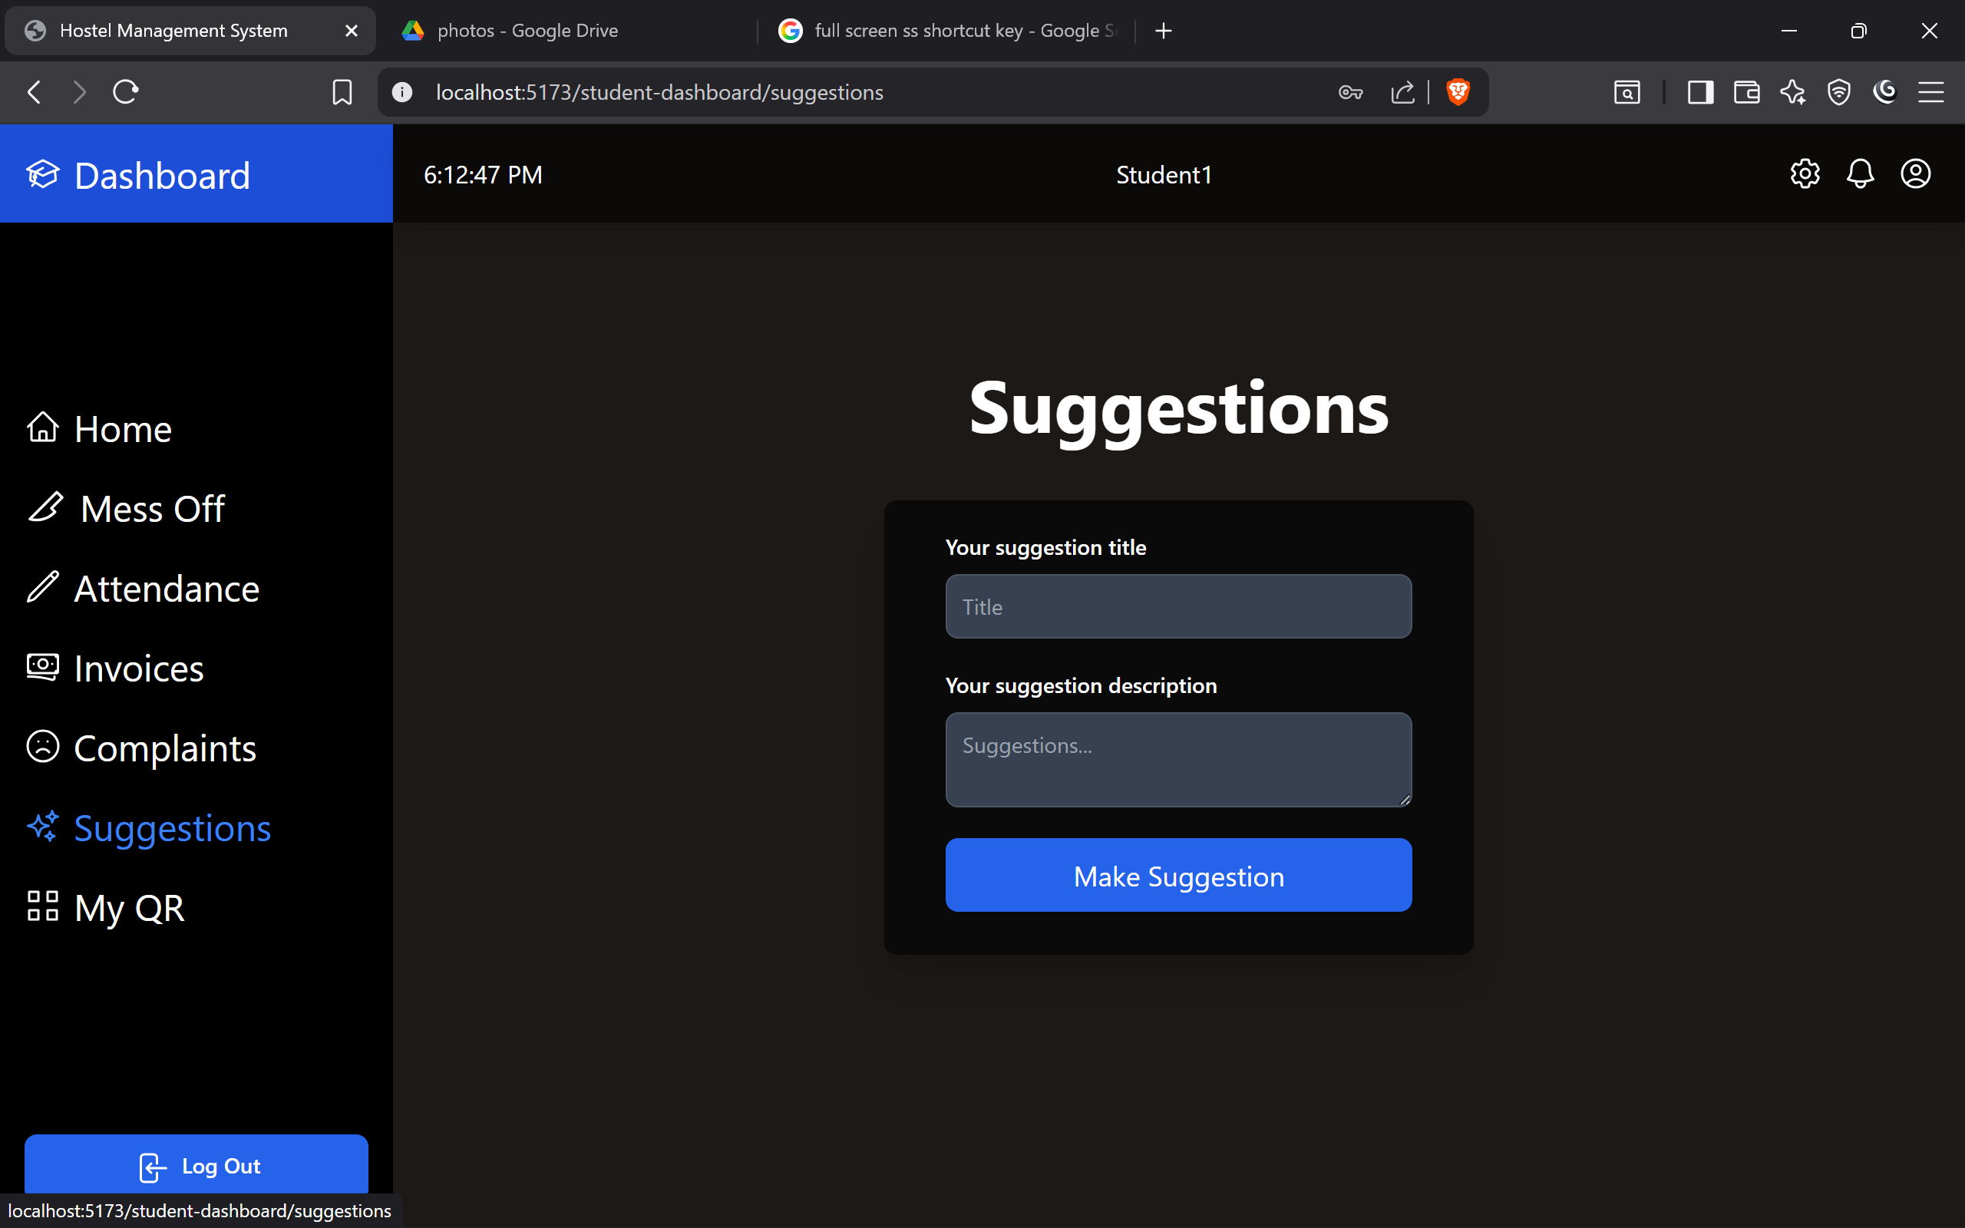
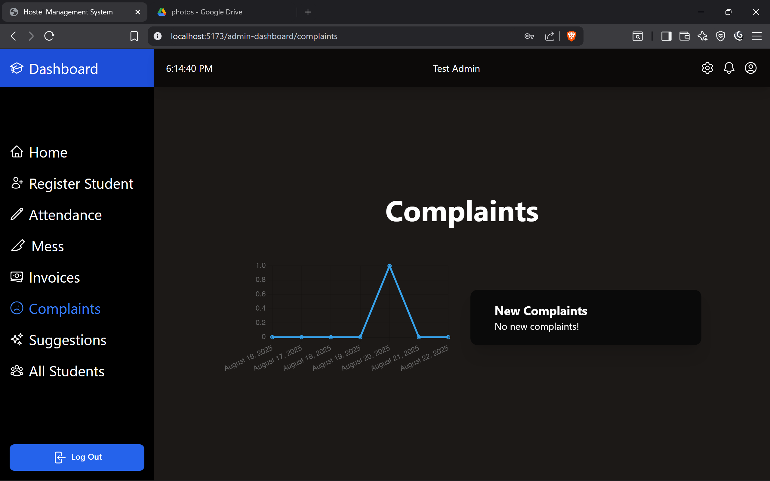
UI Screen

Slide 22
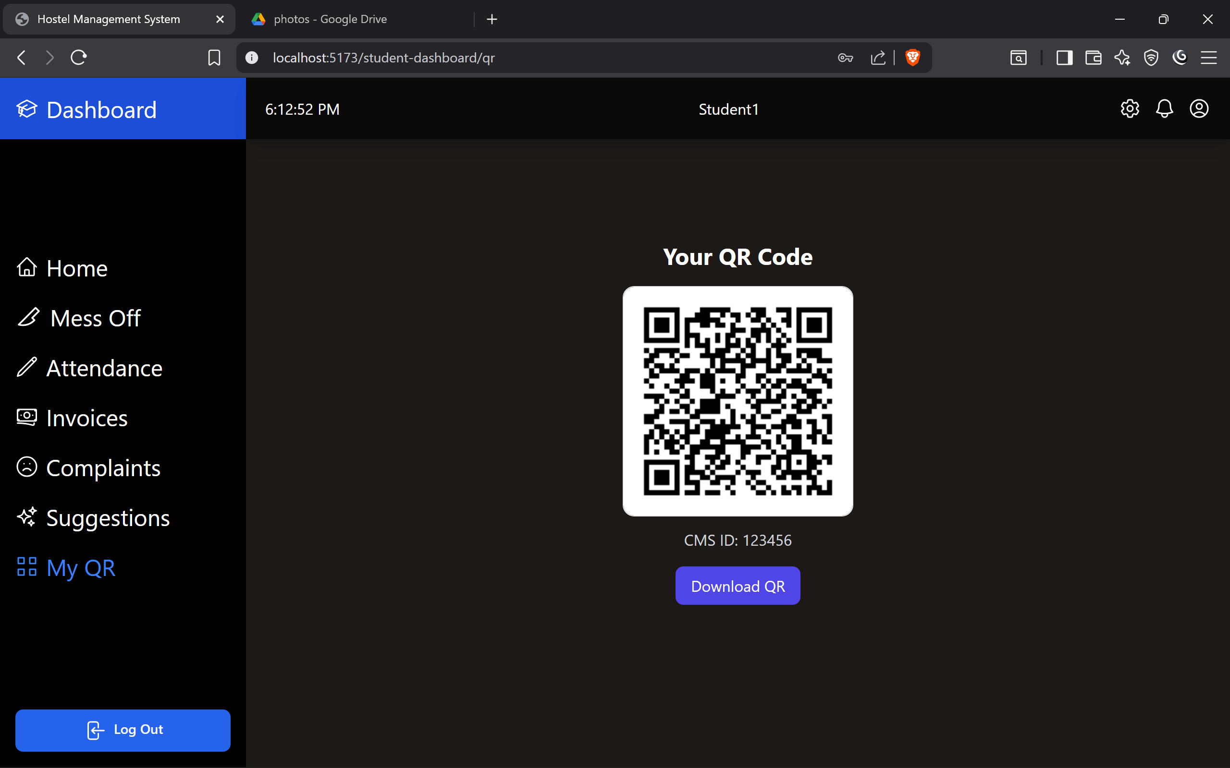
UI Screen

Slide 23
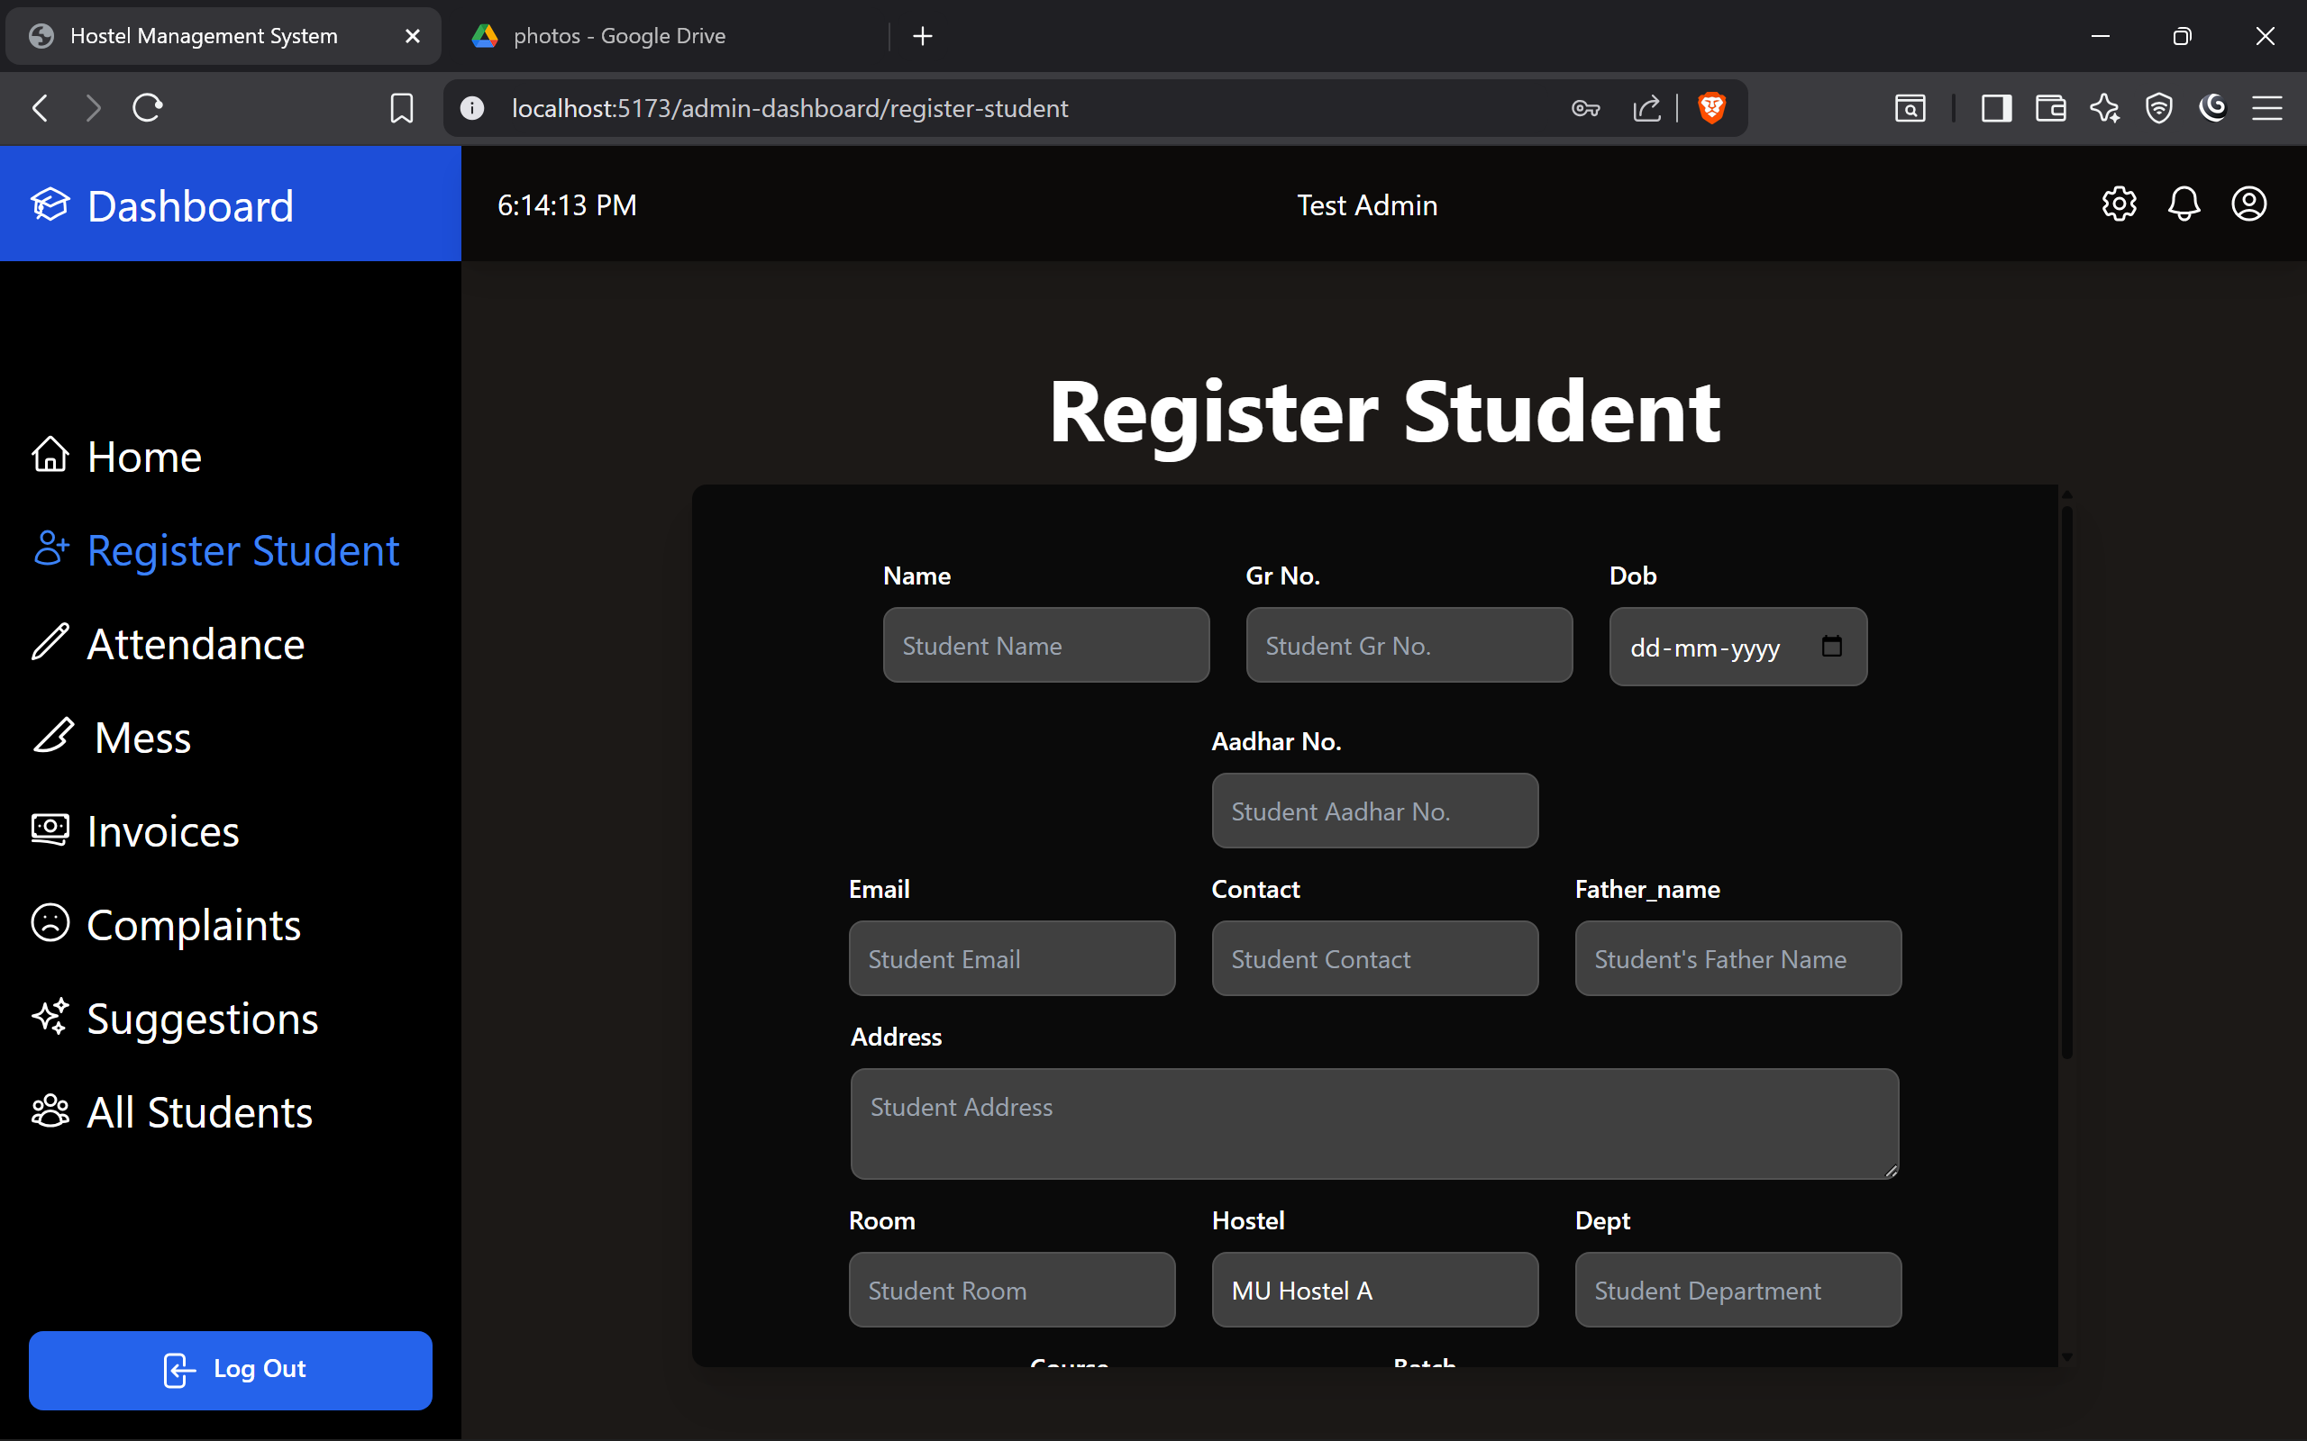
UI Screen

Slide 24
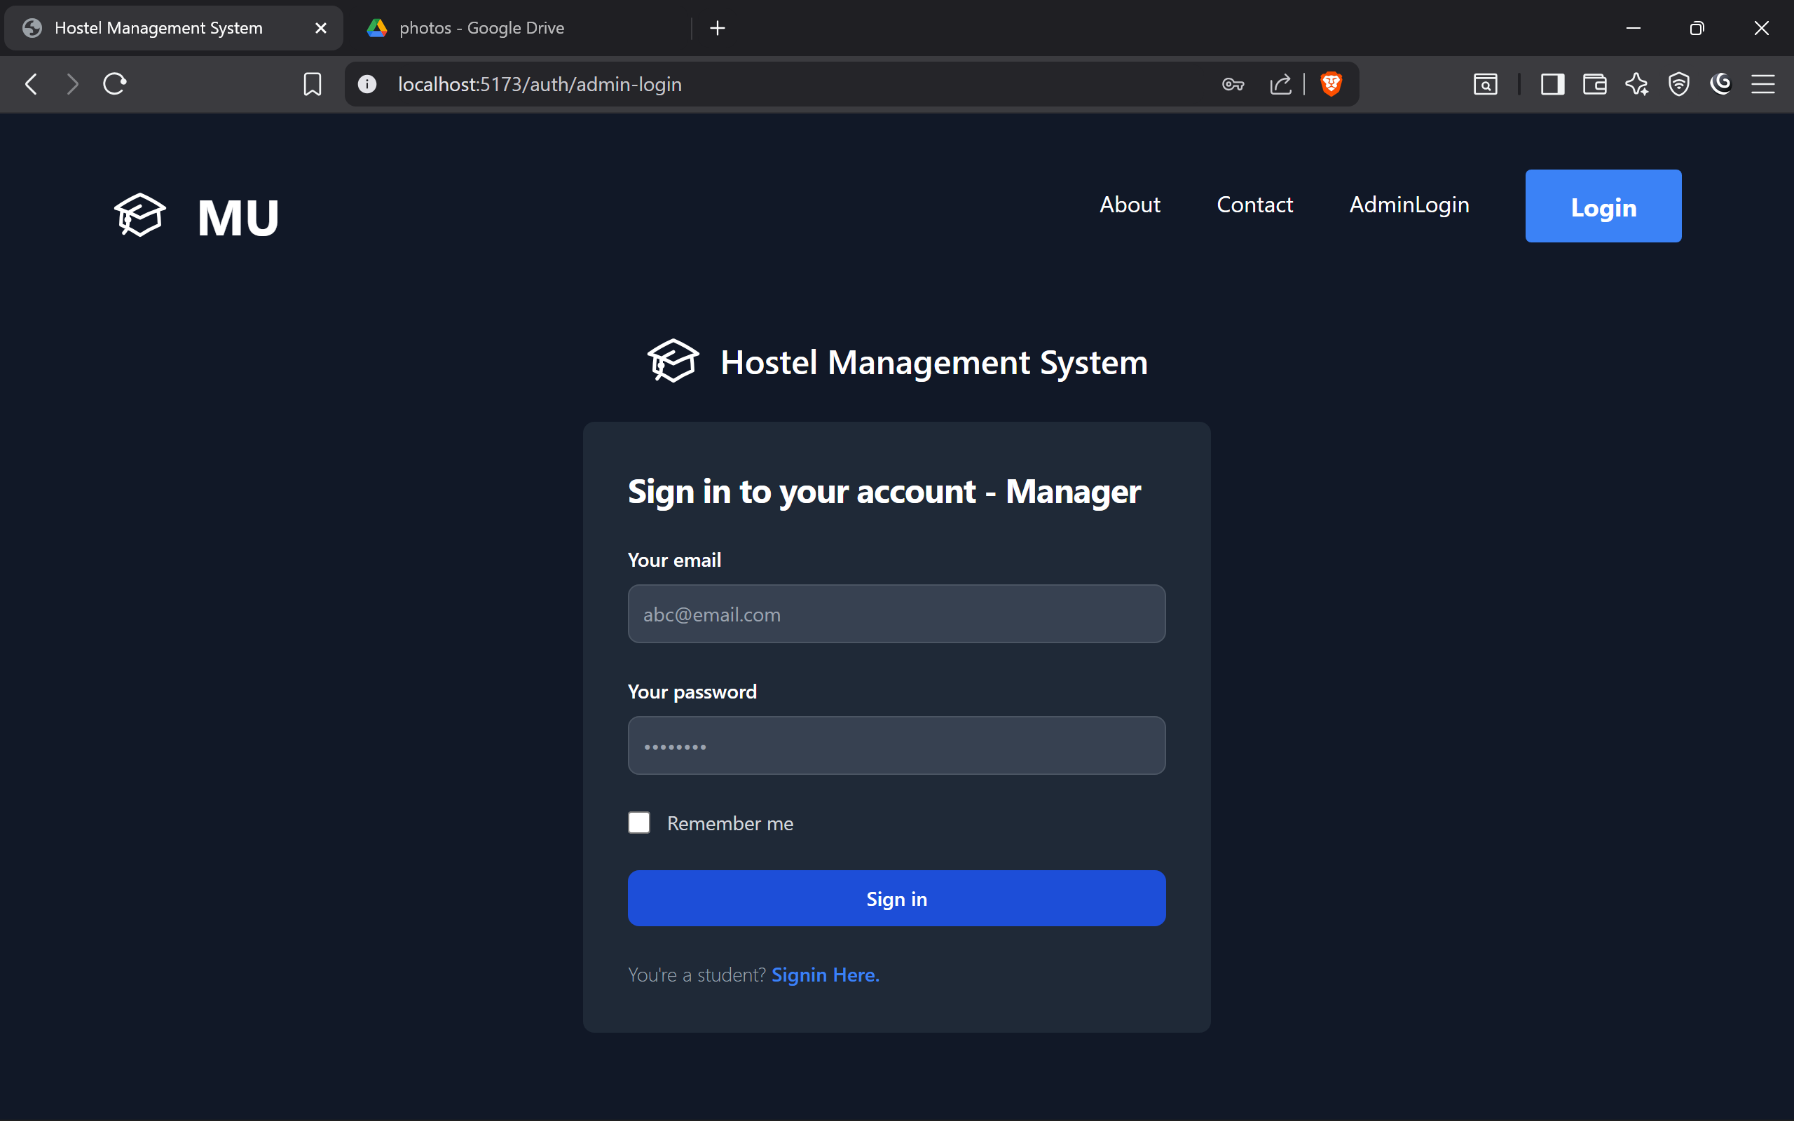
UI Screen

Slide 25
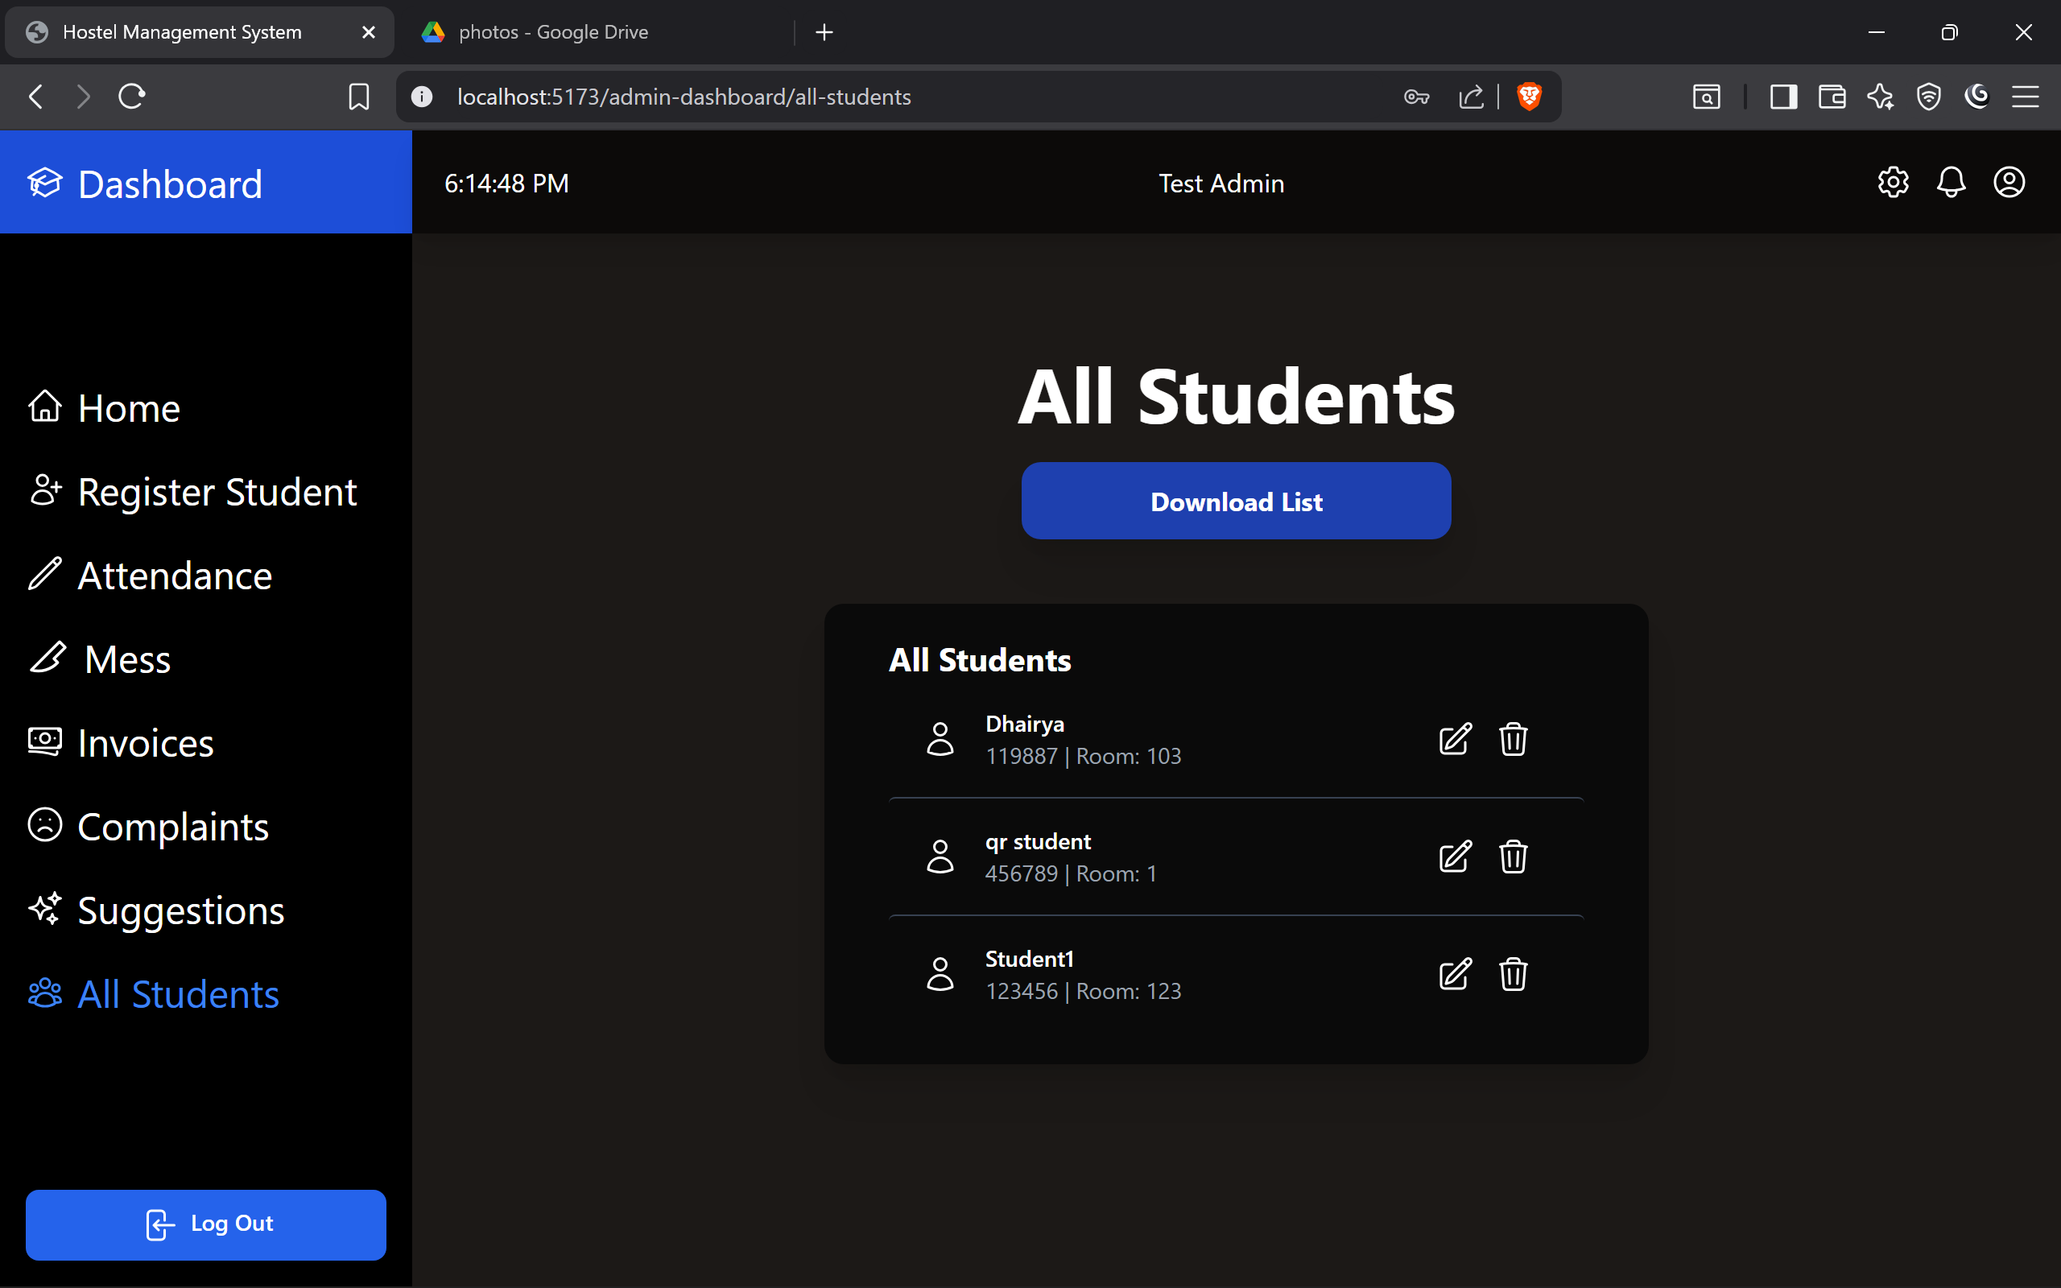
UI Screen

Slide 26
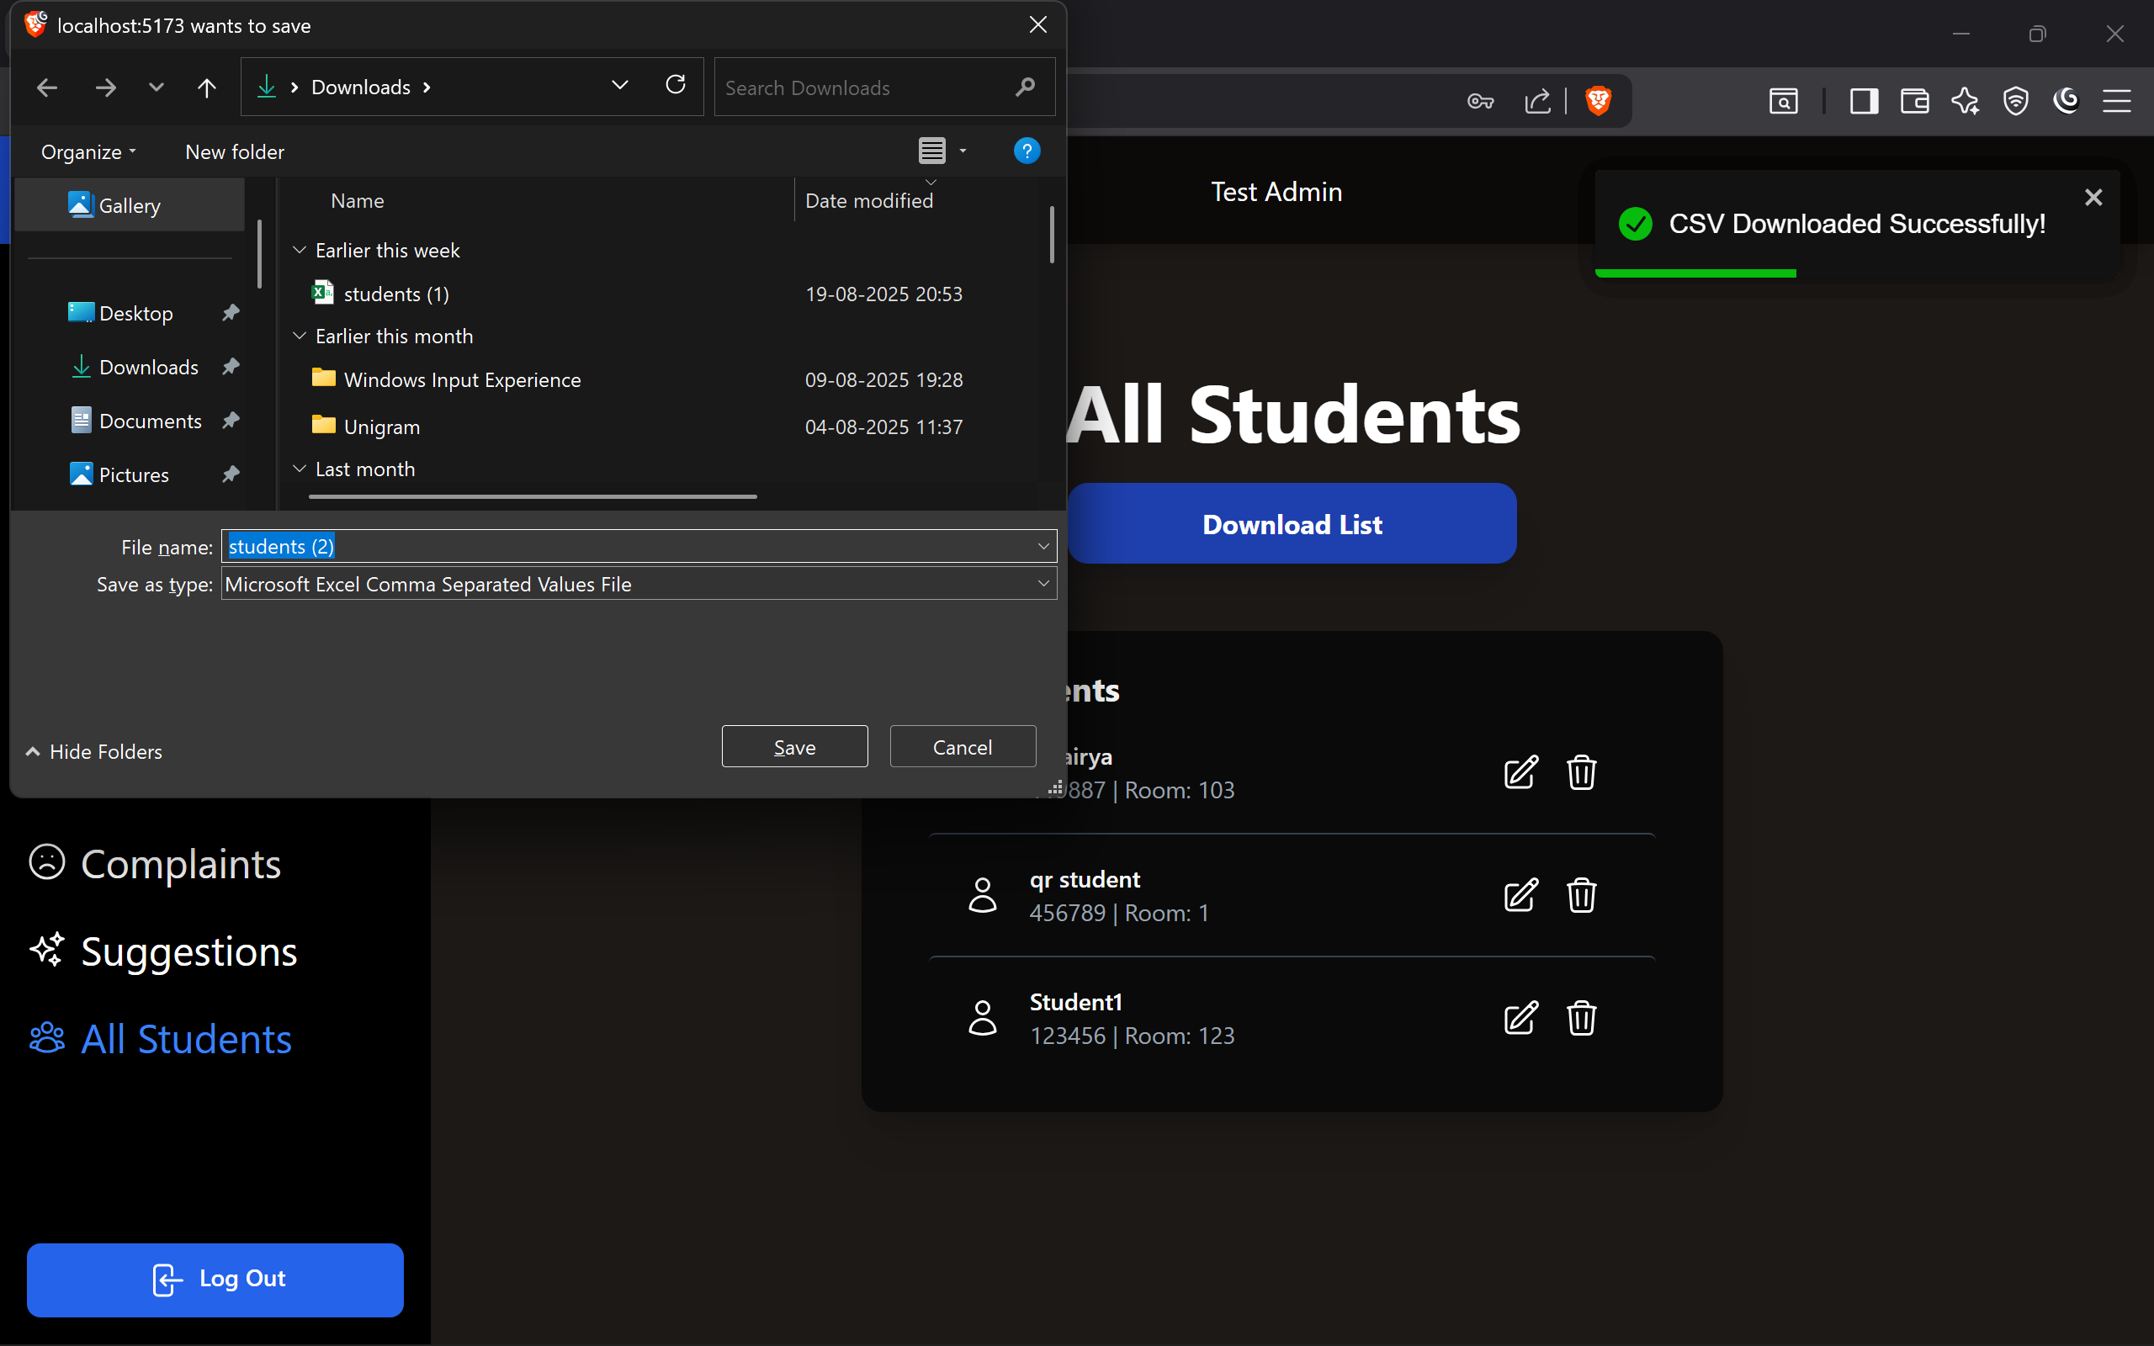
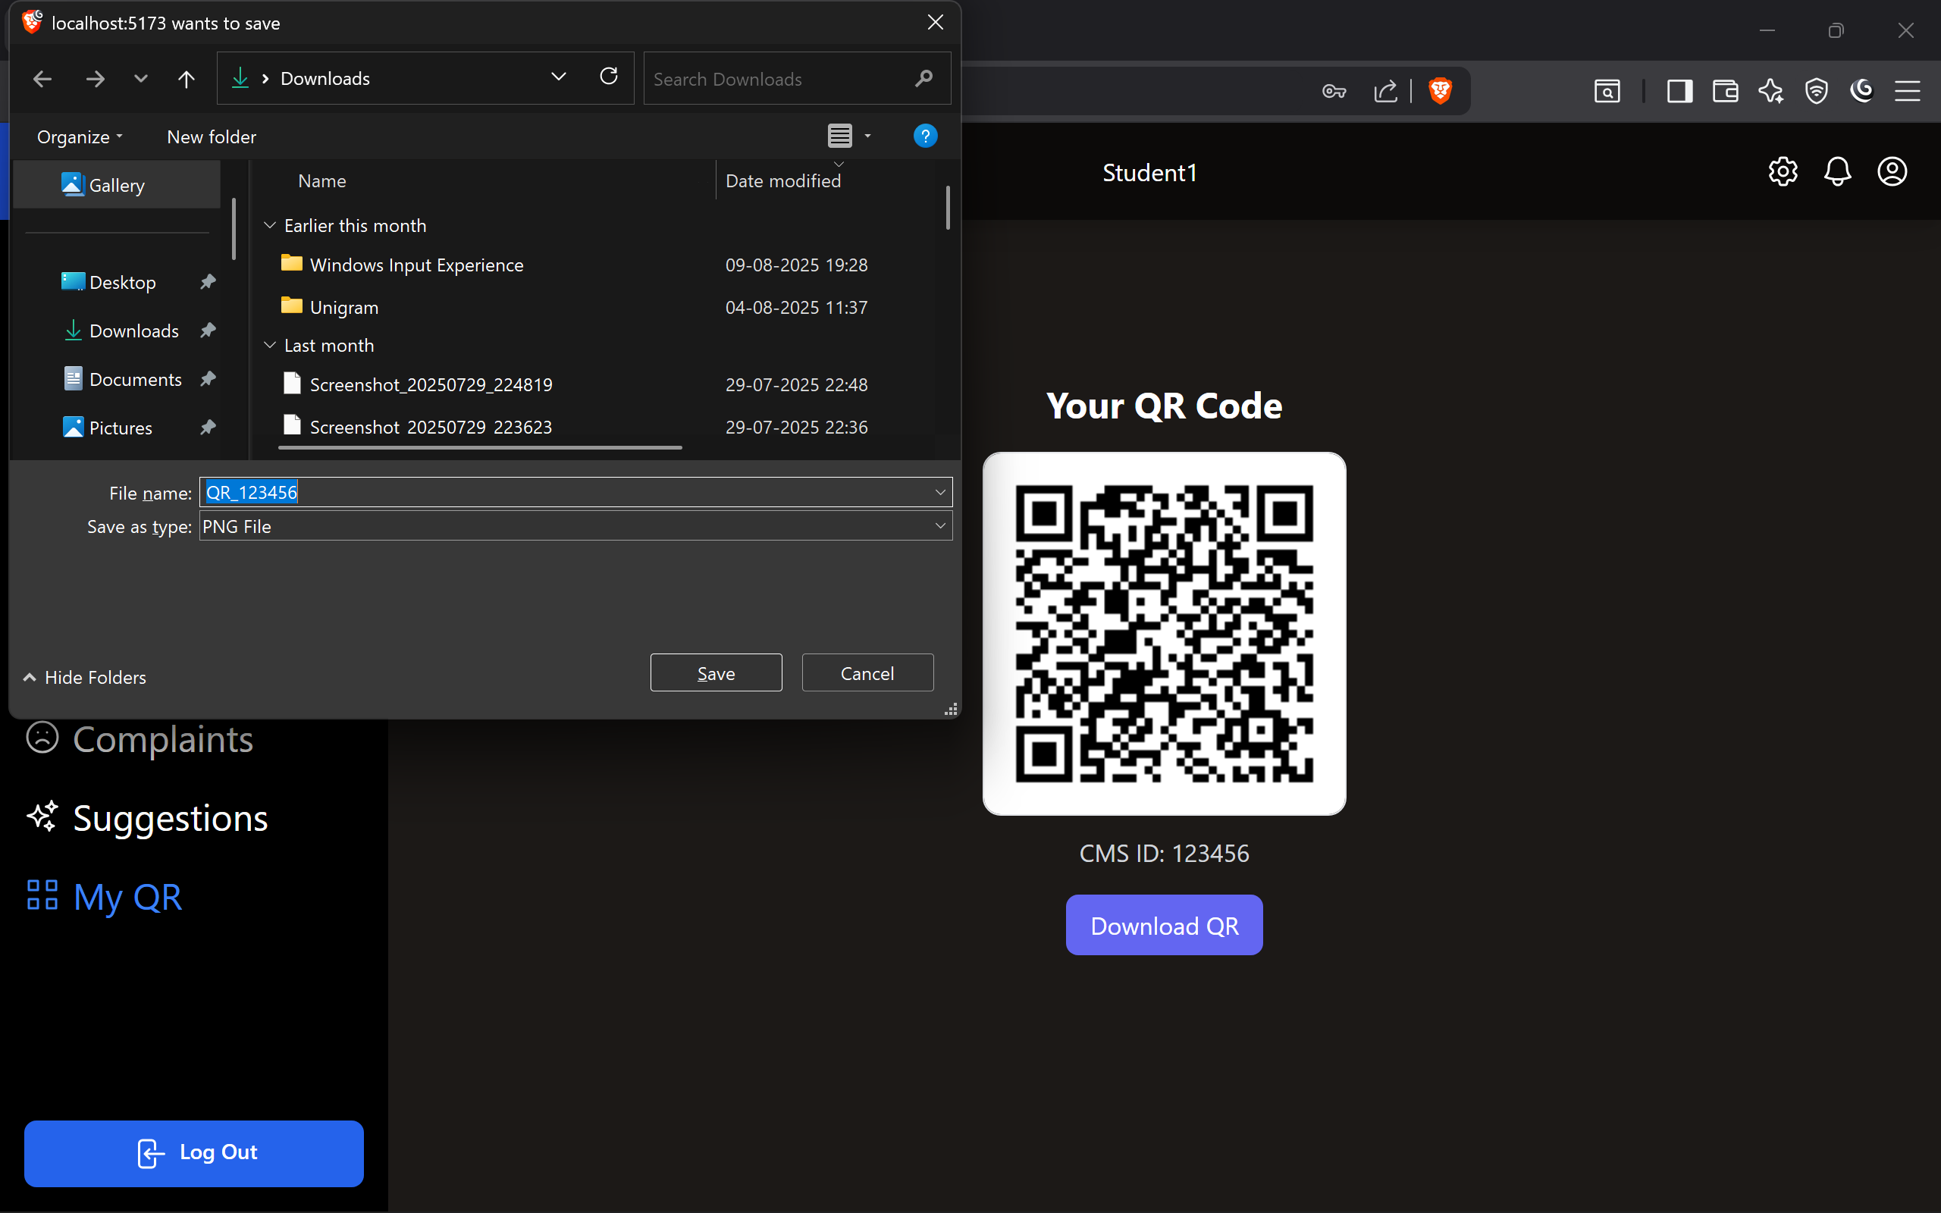
UI Screen

Slide 27
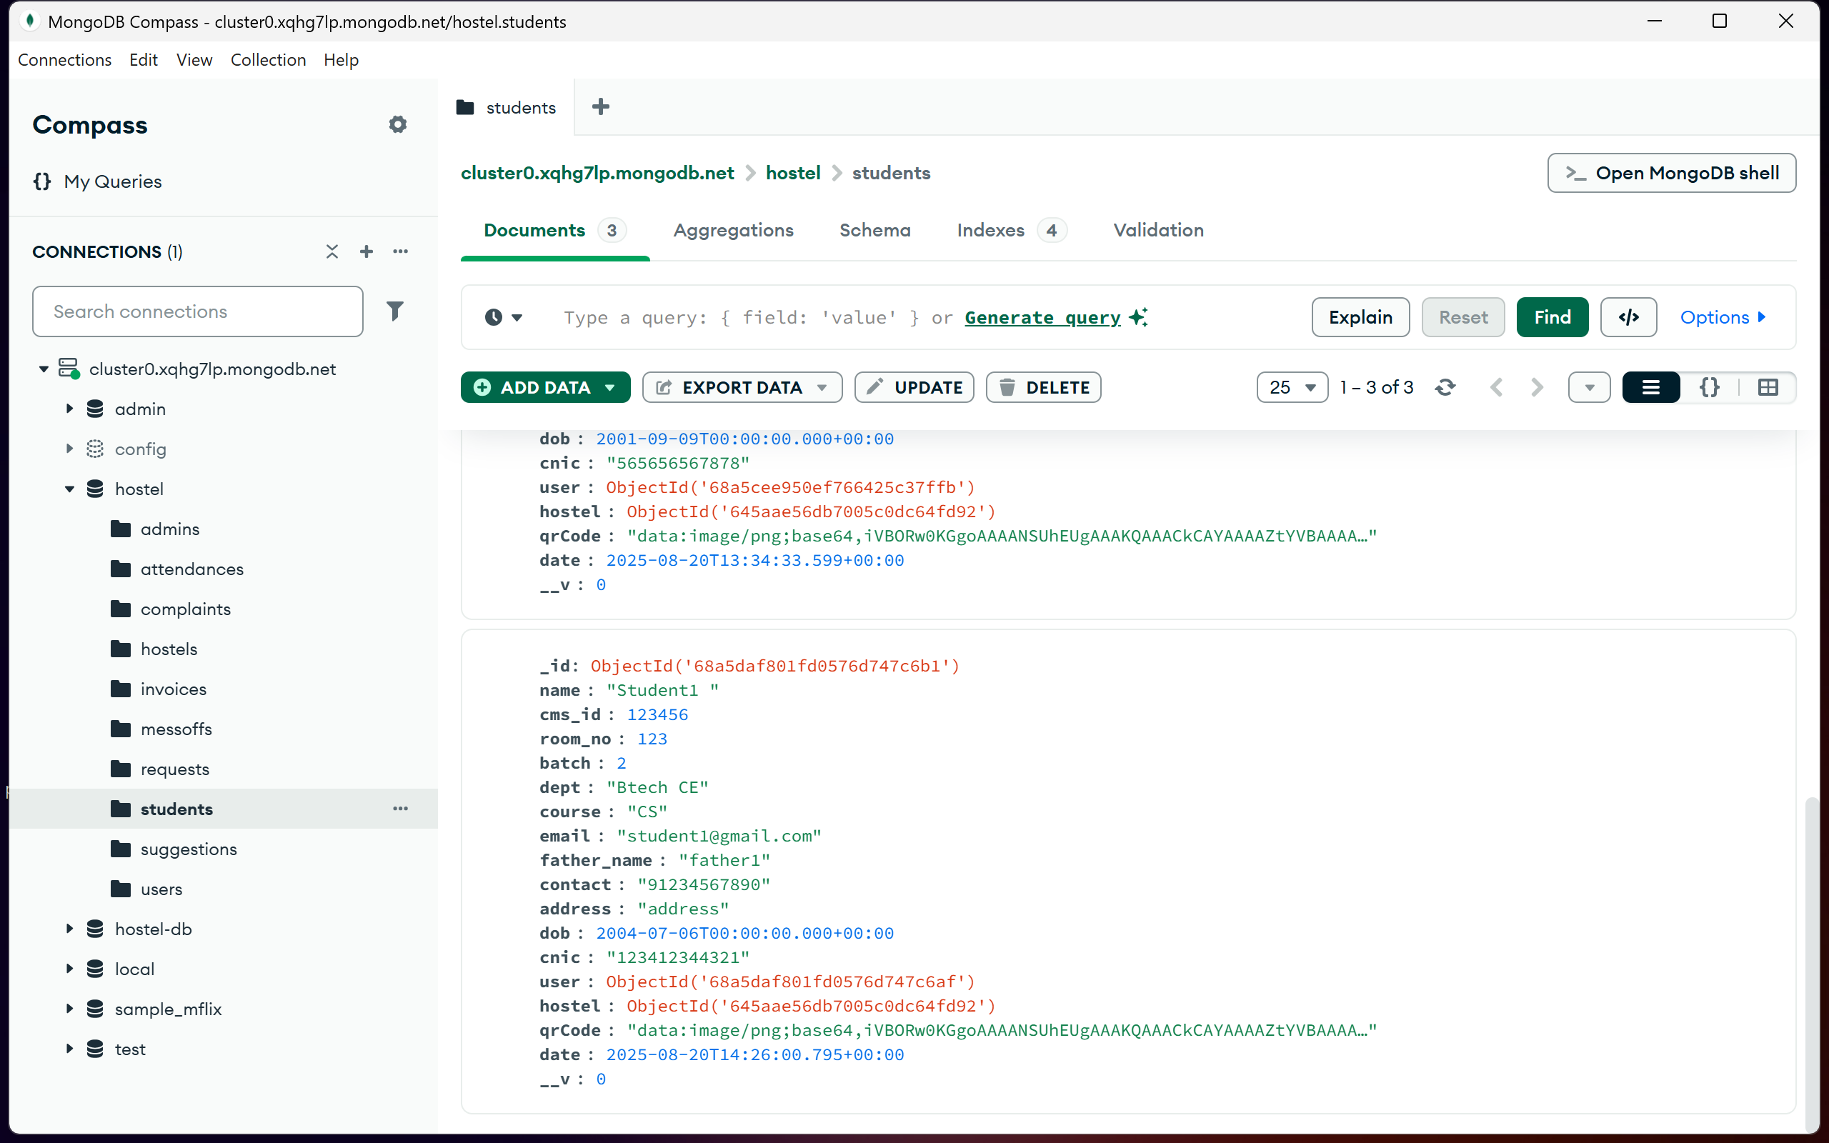
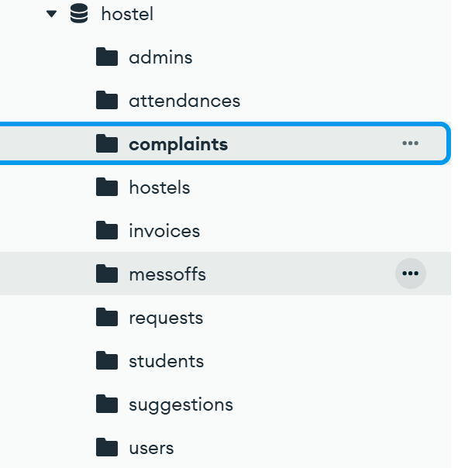
UI Screen

Slide 28
Testing
Test ID | Test Condition | Expected Output | Actual Output | Remark
TC-1 | User enters valid username and password | User successfully logs into the Hostel Management System (dashboard opens) | User successfully logged in | Working
TC-2 | User enters invalid username and/or password | System displays error message: “Invalid credentials” and stays on login page | Error displayed | Working
TC-3 | User (student) views Room Availability from the list / search | List of rooms with details (room no., type, occupancy, rent, status) is displayed | Room details displayed | Working
TC-4 | Admin assigns a room to a student (select student → select room → Allocate) | Room is assigned; student record shows assigned room; room status updates to Occupied | Room assigned and status updated | Working

Slide 29
Testing
Test ID | Test Condition | Expected Output | Actual Output | Remark
TC-5 | Admin deletes a student record (or removes student from hostel) | Student record removed; allocated room becomes Available | Student record deleted; room freed | Working
TC-6 | Student scans QR code at hostel gate | System verifies QR code with student database → if registered, allow entry; else deny access | Entry allowed/denied correctly | Working
TC-7 | Admin logs in with admin role | Admin features visible: allocate rooms, manage fees, view reports, etc. | Admin dashboard displayed | Working
TC-8 | Student logs in with student role | Student can only view room details, fees, complaints, leave requests (no admin rights) | Limited access provided | Working

Slide 30
Expected Outcomes
Fully functional hostel management system that provides accurate and real time information of students.
Admin will be able to easily access real-time updates about students’ room allocation, pending fees, their suggestions and many other features.
The system aims to provide easy and robust management of students living in hostel.

Slide 31
References
MongoDB Documentation. (n.d.). Official MongoDB Documentation.Retrieved from https://www.mongodb.com/docs/ .
React.js Documentation. (n.d.).Retrieved from https://reactjs.org/ .
Node.js Documentation. (n.d.).Retrieved from https://nodejs.org/ .
Express.js Documentation. (n.d.).Retrieved from https://expressjs.com/ .
Marwadi Hostel Portal.

Slide 32


